Slide 1
PM2.5 prediction
- Pranav Nambiar

Slide 2
Details
Github: https://github.com/PranavNambiar123/PM2.5-Prediction-Project-IIT-Kanpur
Roll number: 233562458
IITK email: nambiarpv23@iitk.ac.in

Slide 3
Previously
We implemented basic LSTM
This time we try and improve it’s predictions using better features, spatial data and more complicated model

Slide 4
Enhanced Feature Engineering
Fetched location coordinates and used nearby localities to fill missing data:
Used OpenStreetMap to fetch coordinates for all localities (Spatial cleaned data)
Only considered localities within 10km as nearby localities and used their weighted data to fill missing data ref
Expanded Temporal Features:
Added day of week and weekend indicator features
Created sin/cos transformations for cyclical variables to better capture periodicity. It captures hour 23 is close to hour 0 and December is close to January ref

Slide 5
Enhanced Feature Engineering (contd.)
Advanced Statistical Features:
Added rolling window statistics to capture short term trends (6 hour avg), medium trends (12 hr) and daily trends (24 hr avg)
Added 12-hour min/max values
Implemented long-term lag features (12h and 24h) to capture trends in PM2.5 values
Added more rate-of-change features (6h and 12h) ) to capture trends in PM2.5 values
Improved Data Preprocessing:
Implemented log transformation for the target variable (PM2.5)
Applied robust scaling for features to handle outliers better

Slide 6
Spatial Data resolution
Locality Geolocation Mapping:
Each monitoring station (e.g., Sion, Colaba, Kurla) was mapped to its (latitude, longitude) coordinates.
Distance Calculations:
Computed pairwise Euclidean distances between stations.
Used exponential decay weighting:Weighted Spatial Features:
Created new features using weighted averages of PM2.5 from nearby stations:
For time steps with missing PM2.5:
Retrieved values from nearby stations.
Applied the same exponential weighting to impute the local value.

Slide 7
Final LSTM Architecture
Layers:
Input → Bi-LSTM (64) → Dropout(0.3) → Residual Bi-LSTM (64)
Dense(128) → BatchNorm → Dense(1)
Regularization:
Dropout + recurrent dropout
L2 regularization
Training:
Epochs: 150
Batch size: 64
Early stopping patience: 20
Learning rate: warm-up + ReduceLROnPlateau (decay 0.95 every 500 steps)

Slide 8
Training Result
Locality | MAE | RMSE
Colaba | 1.99 | 4.08
Sion | 4.38 | 5.61
Powai | 5.88 | 8.30
Airport | 6.56 | 8.50
Borivali | 5.95 | 9.14
Worli | 5.73 | 8.47
Kurla | 10.40 | 23.73
Kalyan | 12.31 | 16.93
Bandra | 9.47 | 12.76

Slide 9
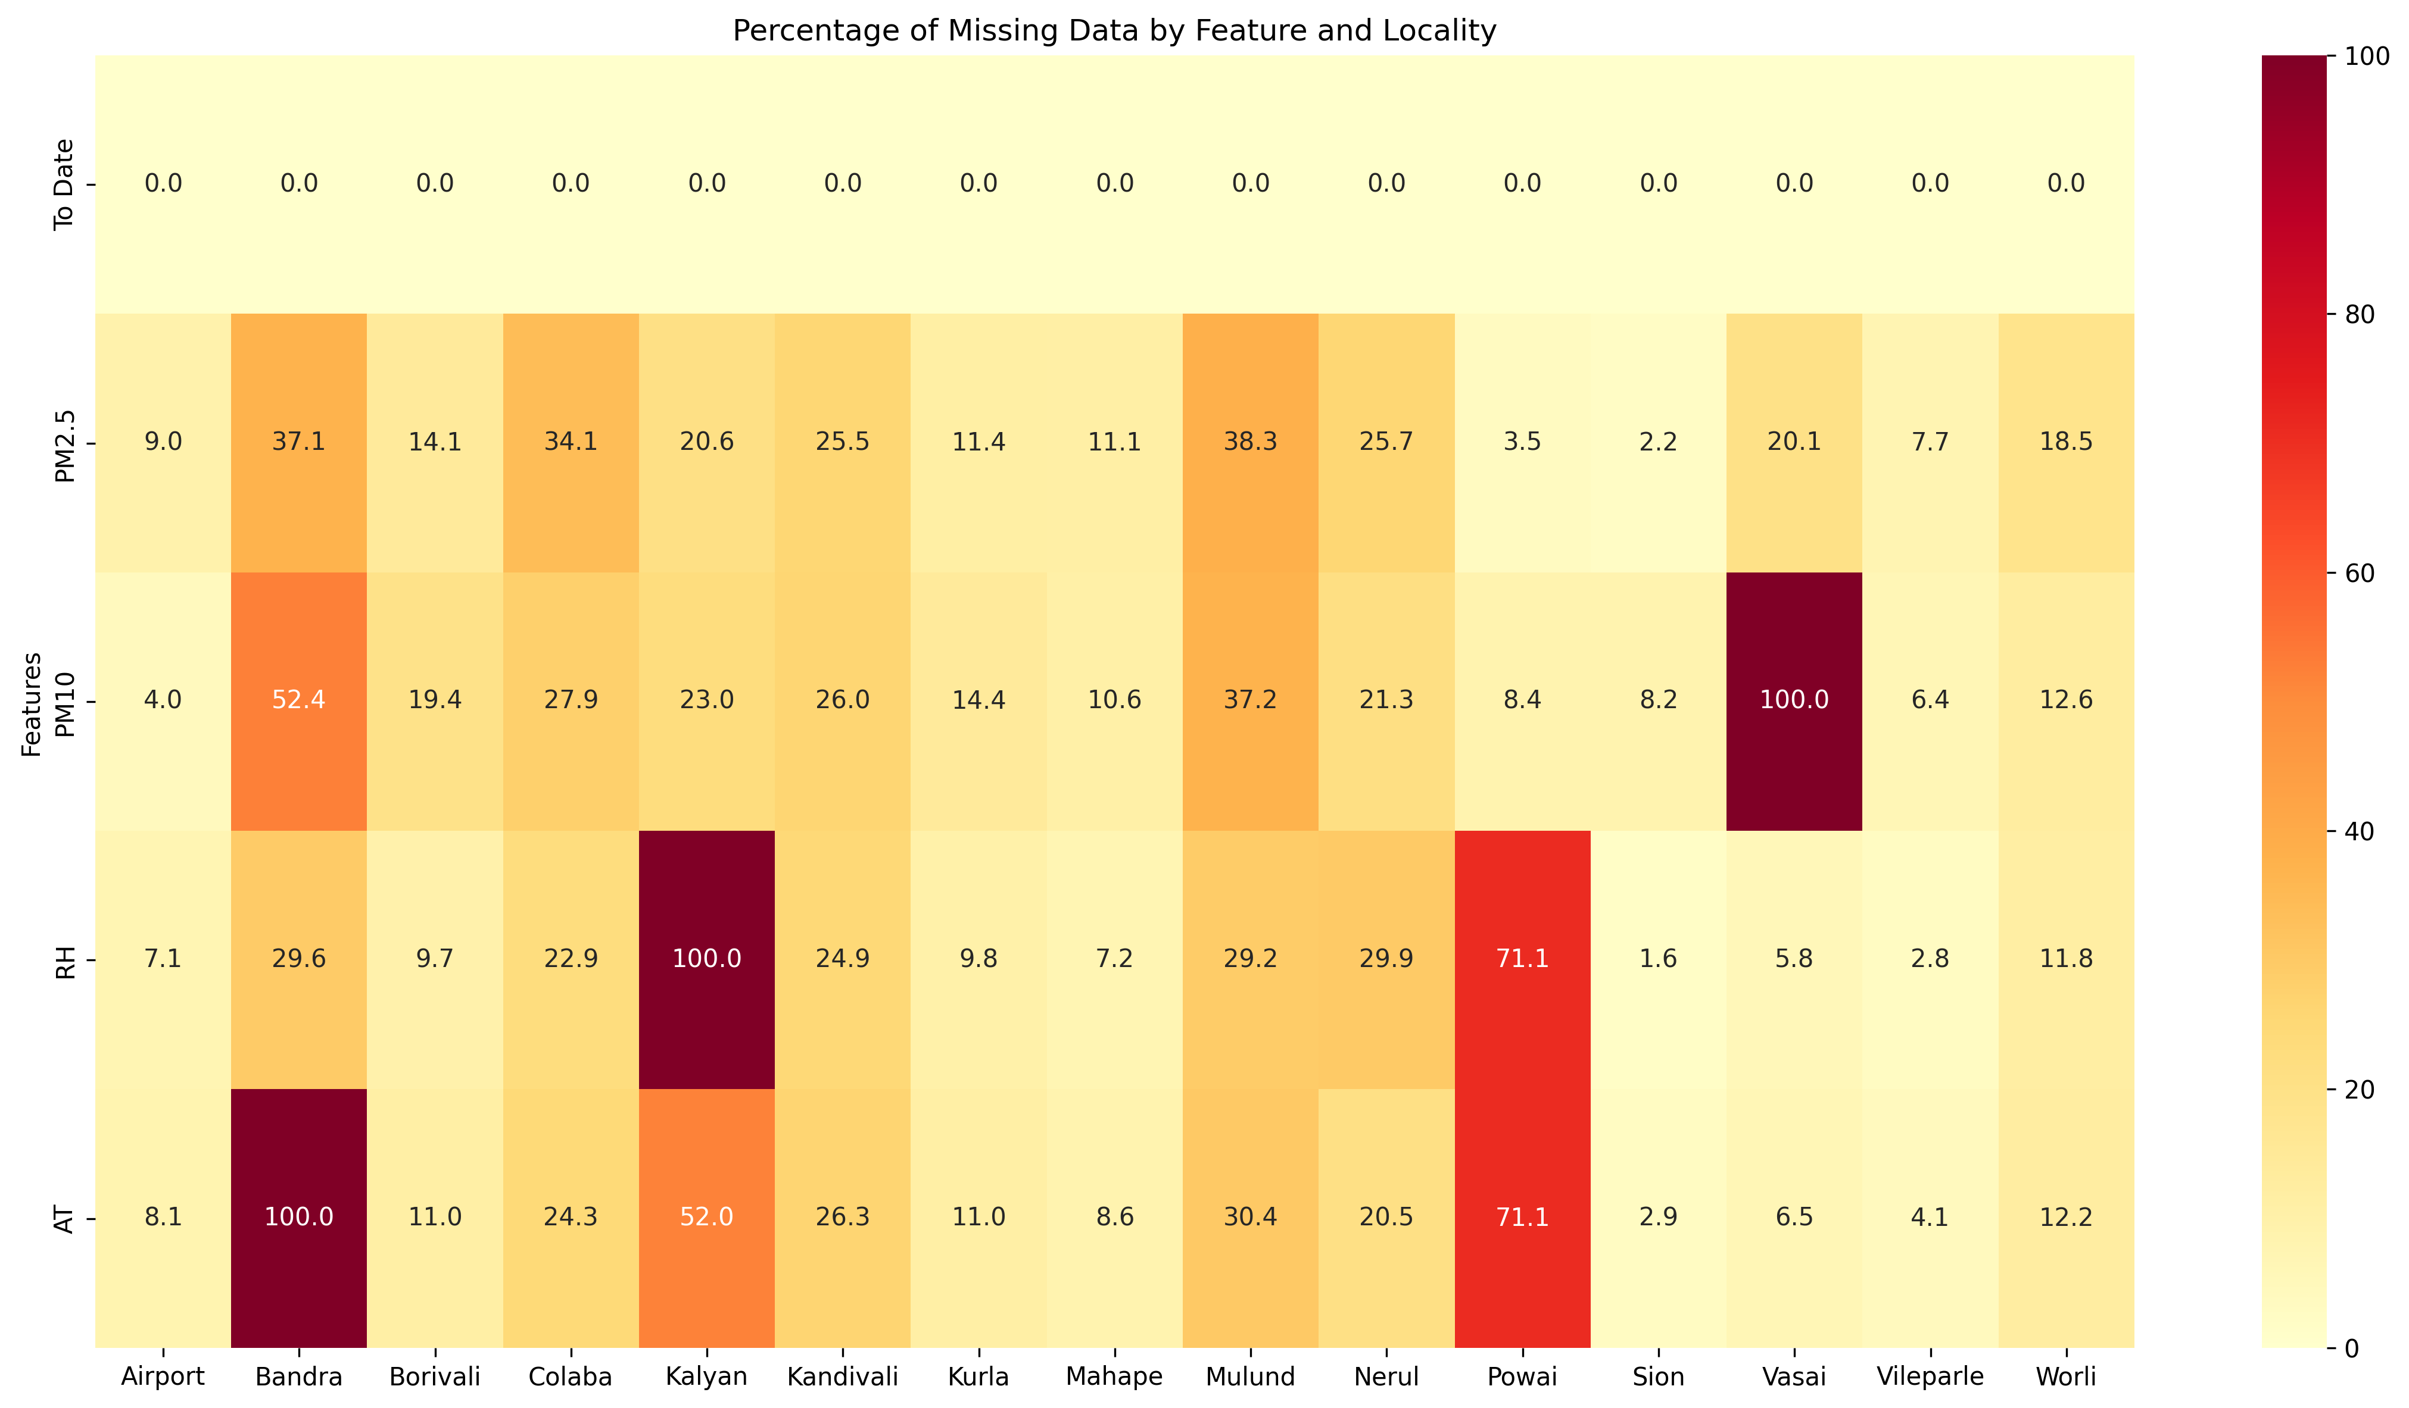
Given the data distribution for each region

Slide 10
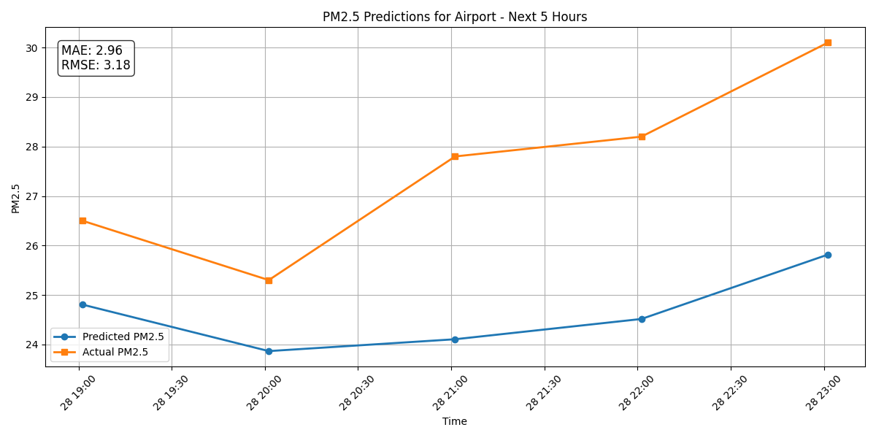
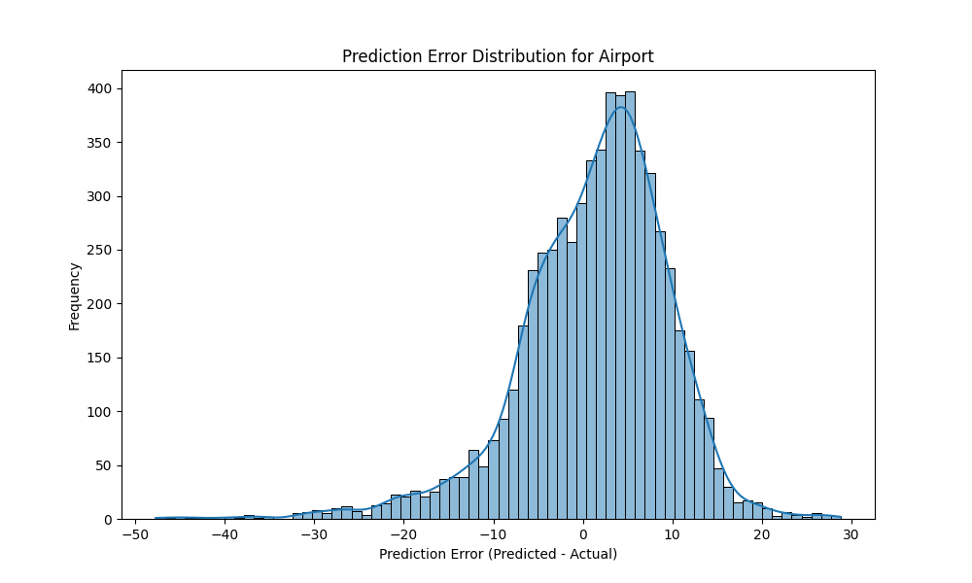
Prediction per region with LSTM
Airport

Slide 11
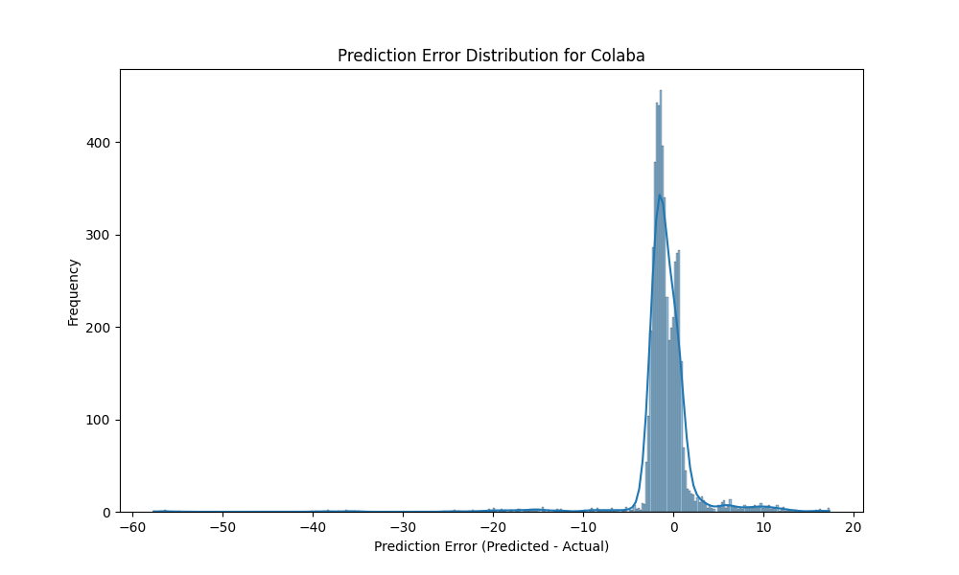
Prediction per region with LSTM
Colaba

Slide 12
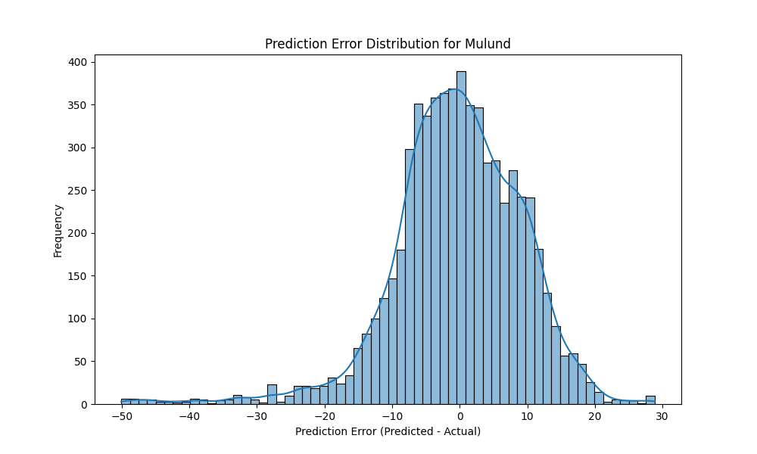
Prediction per region with LSTM
Mulund

Slide 13
Result
Localities with more nearby neighbors (like Colaba, Sion, and Powai) achieved the best results
Localities on the periphery (like Kalyan) showed higher error rates but still significant improvement
The final model significantly outperformed the original implementation, with an 88% reduction in MAE.

